Slide 1
Code Optimisation – an Introduction
Dr G Sudha Sadasivam

Slide 2
Need
improve execution efficiency.
Reduce space occupies by target code and increase speed
Optimisations
Machine independent – intermediate code
Machine dependent – target code
Source level – better algorithms
Local optimisation – portion of code
Speed up ≥ 1.4
Gobal optimisation – like loop – speed up - ≥ 2.7

Slide 3
Properties
The transformation should preserve the meaning of programs. Hence, the optimization should not change output of the program or produce an error.
The transformation should improve the speed efficiency of the program and / or reduce the space occupied by the program.
The transformation must be worth the effort. For example, some transformations can only be applied after a detailed time consuming analysis of the source program. If the procedure is executed only a few times, this effort is worthless.
Includes control flow and data flow analysis
- control flow graphs

Slide 4
Steps
Computation of TAC for the source code segment.
Construction of basic blocks.
Construction of flow graphs
Code Optimisation
Construction of DAGs for each basic block in the flow graph.
Optimisation

Slide 5
A[i] = base + (i –low) * w
A[] [] = base + ((i1-low1) * n2) + i2 – low2) * w
x = A[y,z] A is a 10 x 20 array with lower bounds 0 and 0 --TAC.
t1 = y * 20 // offset until previous row
t1 = t1 + z // offset of element within the row
t2 = c /* array start address*/
t3 = 4 * t1 // each array element is of size 4
t4 = t2[t3] // offset with start address
x = t4.

Slide 6
l-value of the assignment variable or name (L) has two attributes
L.place that is a pointer to the symbol table entry for that name.
L.offset is set to null for a simple variable. Otherwise it is an array. (assignment is for a particular array element)
E -- > L
{ if L.offset = null then
E.place = L.place /* simple expression*/
else {
E.place = newtemp;
Gen(E.place = L.place [L.offset]); /* array expression*/
}

Slide 7
L →Elist ]
For each dimension, the offset of the array is incremented by the width of the dimension given by width(Elist.array)
{ L.place = newtemp;
L.offset = newtemp;
Gen(L.place = c(Elist.array));
emit(L.offset = Elist.place * width(Elist.array))
}
Elist -- > id [ E
When we consider the first dimension of the array, Elist.place is initialized to E.place.
{ Elist.array = id.place;
Elist.place = E.place;
Elist.ndim = 1 }

Slide 8
E.place holds both the value of the expression E and the value of the dimension ‘m’.
When the second dimension is encountered, Elist.ndim (which gives the number of dimensions) is incremented by 1.
Its offset is also incremented by the width of the dimension.
Elist -- > Elist₁ , E
{ t = newtemp;
m = Elist₁.ndim + 1
emit(t = Elist₁.place * limit(Elist₁.array,m));
emit(t = t + E.place);
Elist.array = Elist₁.array;
Elist.place = t;
Elist.ndim = m; }

Slide 9
2. Basic blocks
entered only at the beginning and when entered are executed in sequence without halting or branching
Determine the set of leaders. A leader is the first statement of basic blocks. Rules
First statement is a leader.
Any statement which is the target of conditional or unconditional goto is a leader.
Any statement which initially follows a conditional statement is a leader.
For each leader construct its basic block which consists of the leader and all statement upto but not including the next leader or the end of the program.
Any statement not placed is a block can never be executed and hence can be removed if desired.
= Block 1 – (1) and (2) ; Block 2 is (3 ) to (11)

Slide 10
1. TAC
begin
prod :=0;
i:=1;
do
begin
prod:=prod+a[i]*b[i];
i:=i+1;
end
while i<=20
end
(1) prod :=0 // leader 1
(2) i:=1
(3) t1:=4*i // leader 2
(4) t2:=addr(a)-4
(5) t3:=t2[t1]
(6) t4:=addr(b)-4
(7) t5:=t4[t1]
(8) t6:=t3*t5
(9) prod:=prod +t6
(10) i:=i+1
(11) if i<=20 goto(3)
(12) // leader 3

Slide 11
B1
(1) prod :=0
(2) i:=1
B2
(3) t1:=4*i
(4) t4:=addr(a)-4
(5) t3:=t2[t1]
(6) t4:=addr(a)-4
(7) t5:=t4[t1]
(8) t6:=t3*t5
(9) prod:=prod +t6
(10) i:=i+1
(11) if i<=20 goto(3)
Flow Graph for matrix multiplication

Slide 12
Quick Sort
void quicksort(int m, int n)
{
int i, j;
int v, x;
if (n <= m) return;
i = m-1; j = n; v = a[n];
while(1) {
do i = i+ 1; while (a[i] < v);
do j = j+ 1; while (a[j] > v);
if( i >= j) break;
x = a[i]; a[i] = a[j]; a]j] = x;
}
x = a[i]; a[i] = a[n]; a]n] = x;
quicksort(m, j); quicksort(i+1, n);
}
0. a = addr(a)-4 //l1
i := m-1
j := n
t1 := 4*n
v := a[t1]
i := i+1 //l2
t2 := 4*i
t3 := a[t2]
if t3 < v goto (5)
j :=j-1 //l3
t4 := 4*j
t5 := a[t4]
if t5 > v goto (9)
if i>= j goto (23) //l4
t6 := 4 * i //l6
x := a[t6]
t7 := 4 * i
t8 := 4 * j
t9 := a[t8]
a[t7]:= t9
t10 := 4 * j
a[t10] := x
goto (5)
t11 := 4 * i //l5
x := a[t11]
t12 := 4 * i
t13 := 4 * n
t14 := a[t13]
a[t12]:= t14
t15 := 4 * n
a[t15] := x

Slide 13
(1) i := m-1
2) j := n
3) t1 := 4*n
4) v := a[t1]
B1
(5) i := i+1
(6) t2 := 4*i
(7) t3 := a[t2]
(8) if t3 < v goto (5) B2
B2
(9) j :=j-1
(10) t4 := 4*j
(11) t5 := a[t4]
(12) if t5 > v goto (9) B3
B3
(13) if i>= j goto (23) B6
B4
(14) t6 := 4 * i
(15) x := a[t6]
(16) t7 := 4 * i
(17) t8 := 4 * j
(18) t9 := a[t8]
(19) a[t7]:= t9
(20) t10 := 4 * j
(21) a[t10] := x
(22) goto (5) B2
(23) t11 := 4 * i
(24) x := a[t11]
(25) t12 := 4 * i
(26) t13 := 4 * n
(27) t14 := a[t13]
(28) a[t12]:= t14
(29) t15 := 4 * n
(30) a[t15] := x
B5
B6

Slide 14
3. Local optimisations
Looking into basic blocks
Function preserving transformations
a) Common subexpression elimination – if an expression is evaluated, its value can be reused
(14) t6 := 4 * i
(15) x := a[t6]
(16) t7 := 4 * i
(17) t8 := 4 * j
(18) t9 := a[t8]
(19) a[t7]:= t9
(20) t10 := 4 * j
(21) a[t10] := x
(22) goto (5)
Copy propagation; Dead code elimination
a := b*c;
x := b*c +5;
a := b*c;
x := a+5;
(14) t6 := 4 * i
(15) x := a[t6]
(17) t8 := 4 * j
(18) t9 := a[t8]
(19) a[t6]:= t9
(21) a[t8] := x
(22) goto (5)

Slide 15
a) Global CSE
t2 := 4*I and t4= 4*j. Hence t6 & t8 can be replaced by t2 & t4
(14) t6 := 4 * i
(15) x := a[t2]
(17) t8 := 4 * j
(18) t9 := a[t4]
(19) a[t2]:= t9
(21) a[t4] := x
(22) goto (5)
(14) t6 := 4 * i
(15) x := t3
(17) t8 := 4 * j
(18) t9 := t5
(19) a[t2]:= t9
(21) a[t4] := x
(22) goto (5)

Slide 16
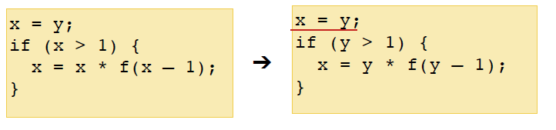
b) Copy propagation
CSE introduces copy propagation
t3:=x; t4:=t3 x 🡪 t3 🡪 t4 ; t3 can be eliminated and written as t3:=x; t4:=x
(14) t6 := 4 * i
(15) x := t3
(17) t8 := 4 * j
(18) t9 := t5
(19) a[t2]:= t9
(21) a[t4] := x
(22) goto (5)
(14) t6 := 4 * i
(15) x := t3
(17) t8 := 4 * j
(18) t9 := t5
(19) a[t2]:= t5
(21) a[t4] := t3
(22) goto (5)

Slide 17
c) Dead code elimination
Copy propagation introduces dead code that cannot be reaches in the program.
If a value is assigned to a variable, that I not used elsewhere then it is dead.
D := 0
…
if D = =1 then goto L2
L2: ….
(14) t6 := 4 * i
(15) x := t3
(17) t8 := 4 * j
(18) t9 := t5
(19) a[t2]:= t5
(21) a[t4] := t3
(22) goto (5)
(14) t6 := 4 * i
(15) x := t3
(17) t8 := 4 * j
(18) t9 := t5
(19) a[t2]:= t5
(21) a[t4] := t3
(22) goto (5)

Slide 18
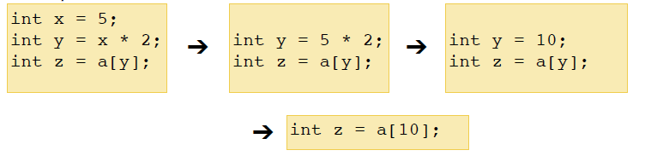
c) Reduction in strength
costly operations like ‘*’ are replaced by less costly operations like ‘+’ Thus i = i * 2 is replaced by i = i + i.
Strlen(strcat(s1,s2)) is costlier than stelen(s1)+strlen(s2)
i*4 is costlier than i<<2
a * 7 ➔ (a << 3) – a
Constant folding
int x = (2+3) * y ➔int x = 5 * y

Slide 19
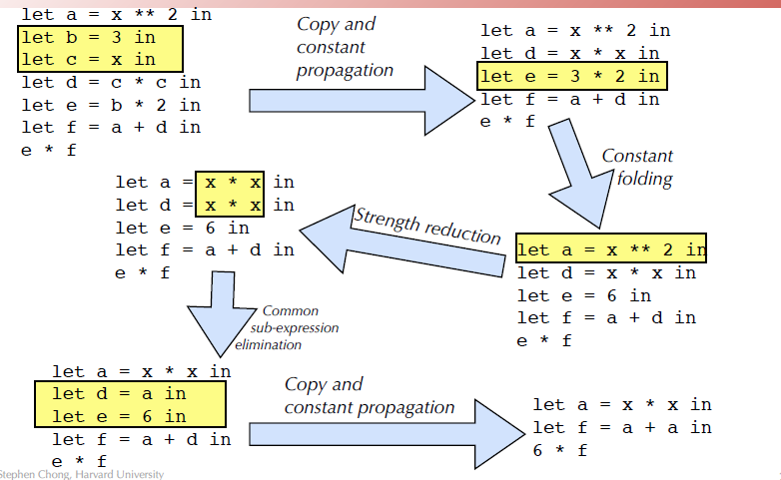
Example

Slide 20
2. Loop Optimisation
a)loop invariants are removed from the loop and placed before it.
n =10
while (i <= n-2)
n =10
t = n-2
while (i <= t)
B1
(1) prod :=0
(2) i:=1
B1
(1) prod :=0
(2) i:=1
B2
(3) t1:=4*i
(4) t4:=addr(a)-4
(5) t3:=t2[t1]
(6) t4:=addr(a)-4
(7) t5:=t4[t1]
(8) t6:=t3*t5
(9) prod:=prod +t6
(10) i:=i+1
(11) if i<=20 goto(3)
B3
(4) t4:=addr(a)-4
(6) t4:=addr(a)-4
B2
(3) t1:=4*i
(5) t3:=t2[t1]
(7) t5:=t4[t1]
(8) t6:=t3*t5
(9) prod:=prod +t6
(10) i:=i+1
(11) if i<=20 goto(3)

Slide 21
b) Induction variable elimination
Two variables are induction variables when they are in arithmetic progression of one another
Eg t1:=4*i ; hence if i is eliminated, i=i+1 becomes t1 = t1+4
i <= 20 becomes t1 <= 76 (ie ( 4*20)-4)
B1
(1) prod :=0
(2) i:=1
B1
(1) prod :=0
(2) i:=1
(4) t4:=addr(a)-4
(6) t4:=addr(a)-4
B3
(4) t4:=addr(a)-4
(6) t4:=addr(a)-4
B3
B4
t1 := 0
B2
(3) t1:=4*i
(5) t3:=t2[t1]
(7) t5:=t4[t1]
(8) t6:=t3*t5
(9) prod:=prod +t6
(10) i:=i+1
(11) if i<=20 goto(3)
B2
(5) t3:=t2[t1]
(7) t5:=t4[t1]
(8) t6:=t3*t5
(9) prod:=prod +t6
(10) t1 := t1 +4
(11) if t1<=76 goto(3)

Slide 22
c) Reduction in strength
costly operations like ‘*’ are replaced by less costly operations like ‘+’ Thus i = i * 2 is replaced by i = i + i.
Strlen(strcat(s1,s2)) is costlier than stelen(s1)+strlen(s2)
i*4 is costlier than i<<2
a * 7 ➔ (a << 3) – a
Constant folding
int x = (2+3) * y ➔int x = 5 * y

Slide 23
Example 2
(1) i := m-1
2) j := n
3) t1 := 4*n
4) v := a[t1]
B1
(5) i := i+1
(6) t2 := 4*i
(7) t3 := a[t2]
(8) if t3 < v goto (5) B2
B2
(9) j :=j-1
(10) t4 := 4*j
(11) t5 := a[t4]
(12) if t5 > v goto (9) B3
B3
(13) if i>= j goto (23) B6
B4
(14) t6 := 4 * i
(15) x := a[t6]
(16) t7 := 4 * i
(17) t8 := 4 * j
(18) t9 := a[t8]
(19) a[t7]:= t9
(20) t10 := 4 * j
(21) a[t10] := x
(22) goto (5) B2
(23) t11 := 4 * i
(24) x := a[t11]
(25) t12 := 4 * i
(26) t13 := 4 * n
(27) t14 := a[t13]
(28) a[t12]:= t14
(29) t15 := 4 * n
(30) a[t15] := x
B5
B6

Slide 24
(1) i := m-1
2) j := n
3) t1 := 4*n
4) v := a[t1]
B1
t2=4*i
t4=4*j
(5) i := i+1 t2=t2+4
(6) t2 := 4*i
(7) t3 := a[t2]
(8) if t3 < v goto (5) B2
B2
(9) j :=j-1 t4=t4+4
(10) t4 := 4*j
(11) t5 := a[t4]
(12) if t5 > v goto (9) B3
B3
(13) if i>= j goto (23) B6
B4
(19) a[t2]:= t5
(21) a[t4] := t3
(22) goto (5)
(27) t14 := a[t1]
(28) a[t2]:= t14
(30) a[t1] := t3
B5
B6

Slide 25
Optimisation of Basic blocks using DAG
(a)S₁ = 4 * I₀ (b) S₂:=addr(A)-4 (c) S3:=S2[S1]
-
*
=[]
*
n6
n3
n5
n3
-
*
n5
n3
n1
n2
n4
n1
n2
4
I0
Addr(A)
4
I0
n4
n1
n2
Addr(A)
4
I0

Slide 26
DAGs
+
c
a := b + c
b := a – d
c := b + c
d := a - d
-
b,d
+
a
d₀
b₀
c₀
+
e
a := b + c
b := b – d
c := c + d
e := b + c
+
a
-
b
+
b₀
c₀
d₀

Slide 27
DAG for optimisation
Peephole optimisation
Global data flow analysis
Definition, reference, evaluation points
Reaching definitions
Available expressions
Live variable
Busy expressions

Slide 28
DAG optimisations
Dead Code Elimination: Isolated nodes / portions of graph not connected to other portions in DAG can be eliminated, as they are portions that cannot be reached
a := b + c
b := b – d
c := c + d
e := b + c
+
e
+
a
-
b
+
c
b₀
c₀
d₀

Slide 29
Peephole Optimisation
Optimisation in small portion of code
Constant folding: evaluation var at compile time when their values are known
x = 7; ... y = x+5; // y is 12
Common Subexpression Elimination : code that is evaluated multiple times
Explicit : (a+b)*i + (a+b)/j;
Implicit: t1=0;i=0; i=i+1; t1=t1+4
Loop Unrolling : if loop is executed less no / fixed times, it can be unrolled
Loop unrolling:
x += 0 * 0;
y += x * x;
x += 1 * 1;
y += x * x;
x += 2 * 2;
y += x * x;
for(i=0; i<3; i++) { x += i * i;
y += x * x; }

Slide 30
Loop unrolling:
x += 0 * 0;
y += x * x;
x += 1 * 1;
y += x * x;
x += 2 * 2;
y += x * x;
Algebraic simplification:
x +=0;
y += x * x;
x += 1;
y += x * x;
x += 4;
y += x * x;
Loop invariants can be shifted outside the loop
Interprocedural optimisation: pass a parameter in a register if both the caller and callee generated code knows about it.
for (i=0; i<strlen(s); i++)
s[i] = tolower(s[i]);
t0=strlen(s);
for (i=0; i<t0; i++)
s[i] = tolower(s[i]);

Slide 31
Argument Culling: When the value of a specific parameter is a constant, a custom version of a called procedure can be generated, in which the parameter is eliminated, and the constant is used directly.
f(x,r,s,1);
int f(int x, float y, char *z, int n)
{ switch (n)
{ case 1: do_A; break;
case 2: do_B; break; ... }}
f_1(x,r,s);
int f_1(int x, float y, char *z)
{ do_A;}
Loop Jamming: Functions performed by two different loops, if possible can be combined together
for (i=0; i<10; i++)
for (j=0; j<10; j++)
c[i][j] = 0;
for (i=0; i<10; i++)
for (j=0; j<10; j++)
for (k=0; k<10; k++)
c[i][j] = c[i][j] + a[i][k] * b[k][j];
for (i=0; i<10; i++)
for (j=0; j<10; j++)
c[i][j] = 0;
for (k=0; k<10; k++)
c[i][j] = c[i][j] + a[i][k] *
b[k][j];

Slide 32
Algebraic Optimisations
Arithmetic identities like the following:
x + 0 = 0 + x = x
x - 0 = x
x * 1 = 1 * x = x
x / 1 = x
Reduction in strength, that involves replacing an expensive operator by a cheaper one.
x ** 2 = x * x
2.0 * x = x + x
x / 2 = x * 0.5
strlen(s1 || s2) = strlen(s1) + strlen(s2)
Constant folding that involves evaluation of constant expressions at compile time and replacement of these expressions by these values.
x = 3 * 2 is evaluated at compile time and the value is x = 6
area = (22.0/7.0) * r ↑ 2, here 22/7 is evaluated at compile time itself

Slide 33
Constant Propagation: Propagation implies replacement of a variable ‘v’ by assigned the value of a constant.
a := 3.1;
…..
x := a* 2.5;
Here a* 2.5 can be evaluated as 3.1* 2.5 during compilation.
Algebraic transformation processes like
x * y = y * x (associative law)
x * ( y + z) = x * y + x * z (distributive law)
+
e
a := b +c
e := c + d + b
TAC
a := b +c
e:= a+ d
+
a
TAC
a := b +c
t:= c+d
e:= t+b
b
c
d

Slide 34
Global Data Flow Analysis
Definition Point: a point in a program containing some definition.
Reference Point: a point in a program containing a reference to a data item.
Evaluation Point: a point in a program containing evaluation of expression.

Slide 35
Available expression
A expression a+b is said to be available if none of the operands gets modified before their use.
It is used to eliminate common sub expressions.

Slide 36
Reaching definition
A definition D is reaches a point x if there is path from D to x in which D is not killed, i.e., not redefined.
It is used in constant and variable propagation.

Slide 37
Live variable
A variable is said to be live at some point p if from p to end the variable is used before it is redefined else it becomes dead
It is useful for register allocation.
It is used in dead code elimination.

Slide 38
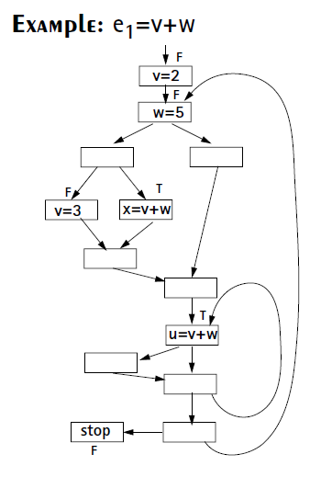
Busy Expression
An expression is busy along a path iff its evaluation exists along that path and none of its operand definition exists before its evaluation along the path.
It is used for performing code movement optimization.

Slide 39
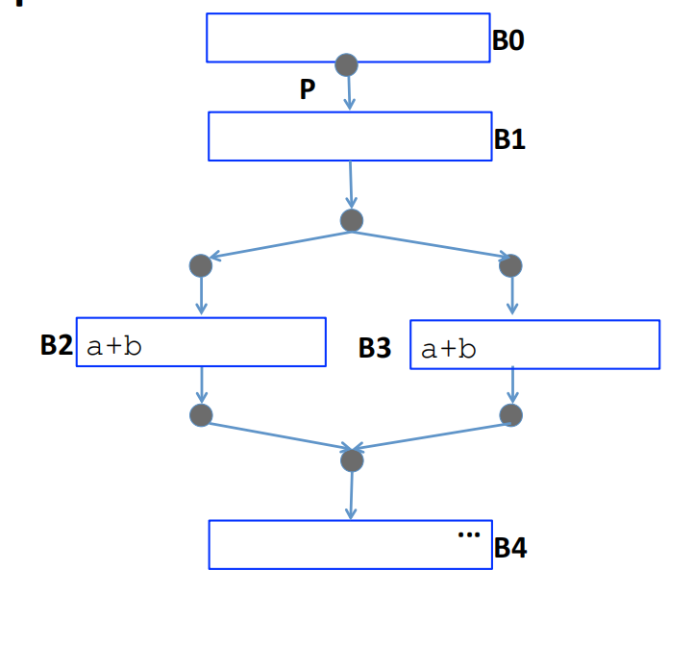
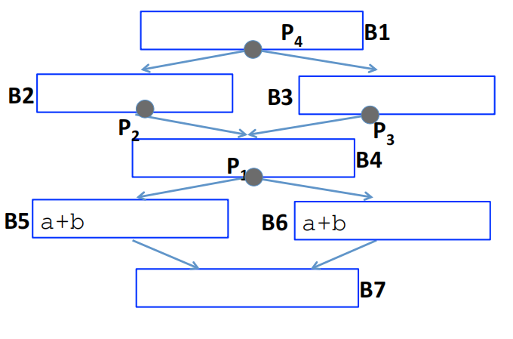
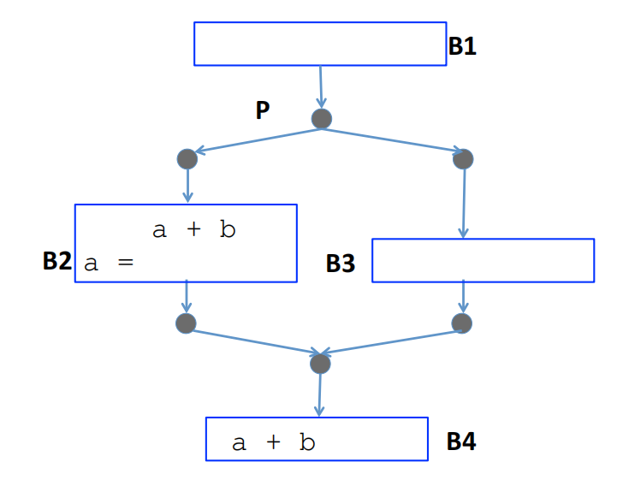
Not busy

